Slide 1
Video Processing Multimedia Feature Extraction

Slide 2
Outline
Frames extraction from Video
SIFT
Shot Transition (Key Frame Detection)
Video Production

Slide 3
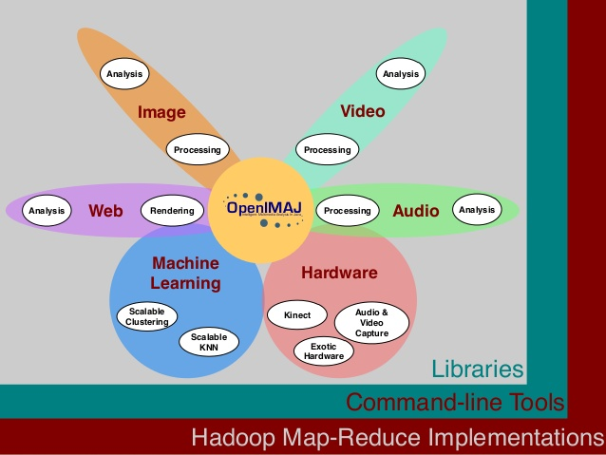
OpenIMAJ
OpenIMAJ is a set of libraries and tools for multimedia content analysis and content generation.
state-of-the-art computer vision (e.g. SIFT descriptors, salient region detection, face detection, etc.)
advanced data clustering,
performs analysis on the content, layout and structure of webpages.
http://openimaj.org/

Slide 4

OpenIMAJ
Library for multimedia content analysis
http://openimaj.org/tutorial/index.html

Slide 5
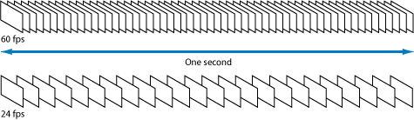
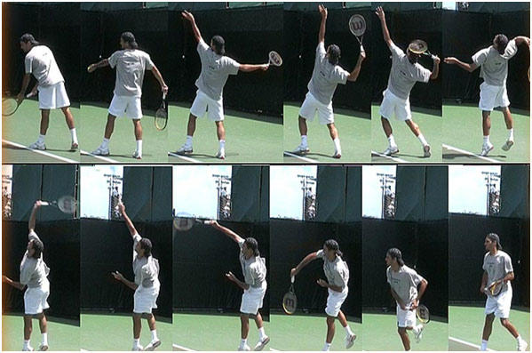
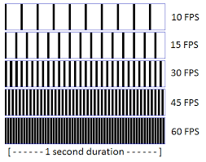
Frames

Slide 6
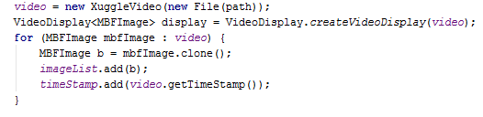

Frames Extraction
Iterating over Video Frames

Slide 7
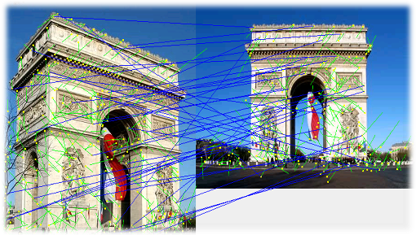
SIFT – Scale Invariant Feature Transform
Addresses the problem of matching features with changing scale and rotation
Very successful; experiments have shown it is one of the best approaches for feature matching
Widely used for recognizing objects from image databases matching

Slide 8
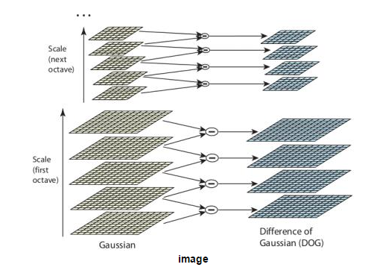
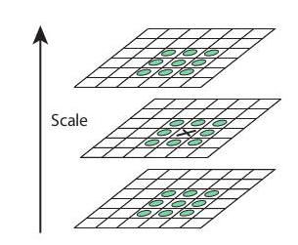
SIFT – Scale Invariant Feature Transform
Scale-space Extrema Detection

Slide 9
SIFT – Scale Invariant Feature Transform
Keypoint Localization
Once potential keypoints locations are found, they have to be refined to get more accurate results
They used Taylor series expansion of scale space to get more accurate location of extrema, and if the intensity at this extrema is less than a threshold value (0.03 as per the paper), it is rejected.
Orientation Assignment
An orientation is assigned to each keypoint to achieve invariance to image rotation

Slide 10
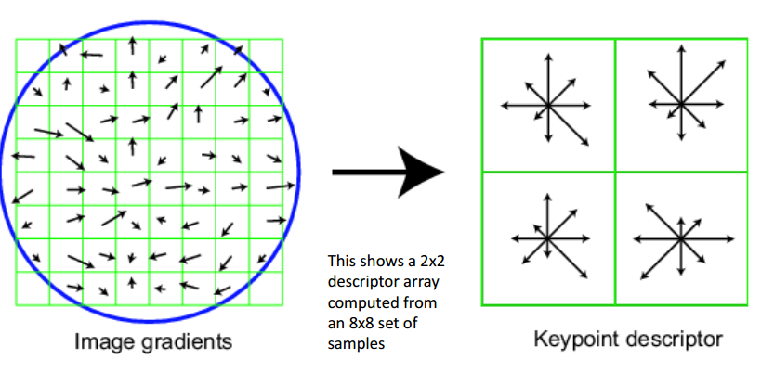
SIFT – Scale Invariant Feature Transform
Keypoint Descriptor
A 16x16 neighbourhood around the keypoint is taken. It is divided into 16 sub-blocks of 4x4 size. For each sub-block, 8 bin orientation histogram is created. So a total of 128 bin values are available. It is represented as a vector to form keypoint descriptor

Slide 11
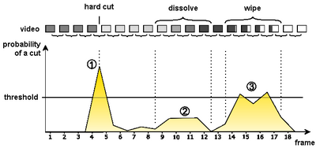
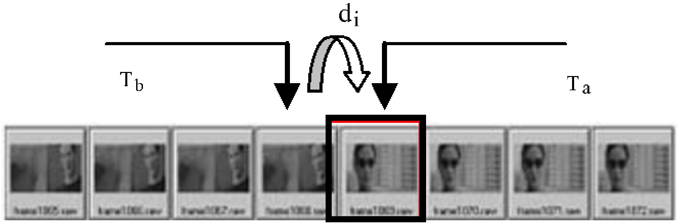
Shot Transition Detection
Shot transition detection (shot detection also called cut detection)
The automated detection of transitions between shots in digital video with the purpose of temporal segmentation of videos.
Compute the threshold based on image features such as SIFT

Slide 12
Shot Transition Detection
Comparing the SIFT features with adjacent images
If common features are less than Threshold, it is shot transition
Retrieving SIFT Key points in the image

Slide 13
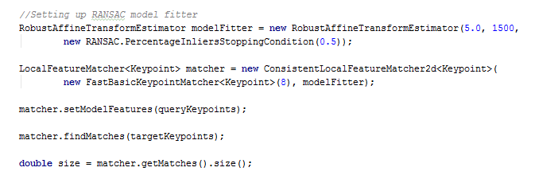
Key Frame Detection (Shot Transition)

Slide 14
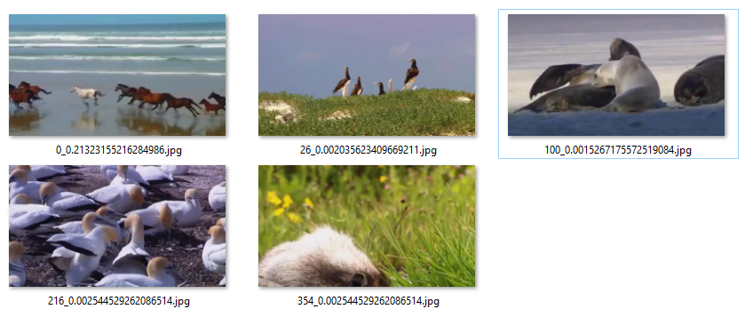
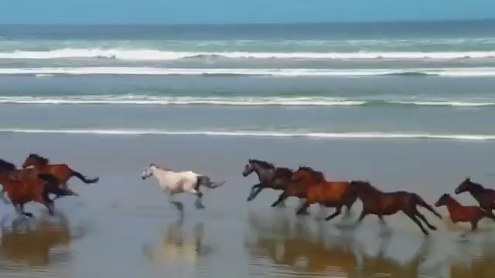
Shot Transition Detection (Key Frames)
Original Video
Key Frames Detected

Slide 15
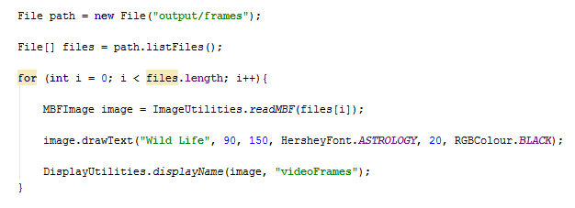
Video Production
Creating video from series of frames/images

